Slide 1



Connecting for Good Challenge:
COVID-19 Relief

Slide 2

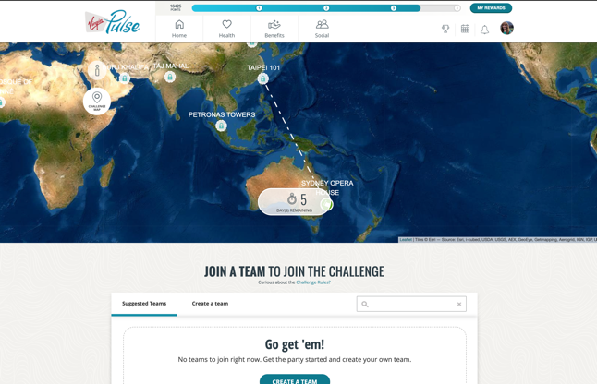
What is the COVID-19 Relief challenge?
Challenge Description: This past year changed everything—but it also brought us closer. Families reached out. Neighbors stepped up. Communities inspired one another. Let’s keep the momentum going! Invite your friends and join a global mission for a good cause. Get active, unlock sky-high adventures, and raise money for COVID-19 relief, every step along the way.
The challenge will bring multiple companies together in a “cross sponsor challenge” to connect for good. For every million steps, Virgin Pulse is donating $10 (up to $100k) to the World Health Organization (WHO) COVID-19 Solidarity Response Fund.

Slide 3
Cross Sponsor Challenge Details
Teams are comprised of members from within one single company. Teams from opposing organizations will compete against each other.

Slide 4

Team & Challenge Rules
Good to know:
The challenge is 3 weeks long and has 20 destinations
Teams can have up to 5 participants
Team scores are based on total team steps. The more steps your team gets, the better your score.
30,000 steps per day maximum per participant
Challenge Reward Details:
No team winner rewards
Reward is charity! For every million steps, Virgin Pulse is donating $10 (up to $100k) to the World Health Organization (WHO) COVID-19 Solidarity Response Fund.

Slide 5

Your Role During the Challenge
It is recommended that each champion creates their own team and does not join a team with other champions on it.
Promote registration at your site or virtually! The best way to create excitement around the step challenge is to talk about it.
Be interactive and post a comment or photo in the challenge chat at least once a week for all 3 weeks of the COVID-19 Relief Challenge.
Available marketing assets:
Challenge FAQ
1 virtual background
1 social media/intranet image
1 digital display
1 flyer

Slide 6
Placeholder to insert an image of the digital display (optional)

Slide 7
Timeline
Promotions
Registration launches on August 30th, so promotion can begin the same day.
Week of Monday August 30th: Post the digital display or flyer in person or virtually using email or company channels
Week of Tuesday, September 7: Remind others to register
Monday, September 13: Challenge starts — send or post inspirational message for your teammates!
Friday, October 1: Remind people that the upload deadline is Tuesday
Challenge Dates
Monday 8/30 – Registration Opens
Monday 9/13 – Challenge Start Date
Thursday 9/16 – Team Changes Deadline
Sunday 10/3 – Challenge End Date
Tuesday 10/5 – Upload Deadline
Friday 10/22 – Challenge is Removed from Platform

Slide 8

Appendix

Slide 9
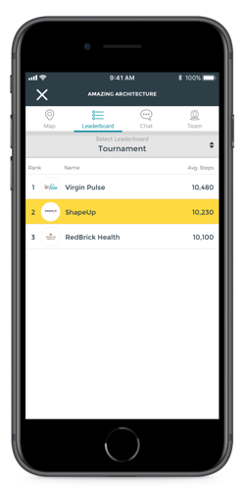

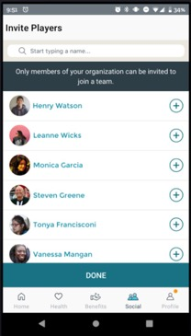
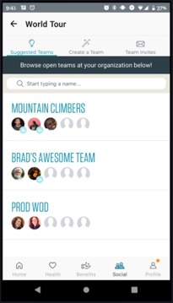
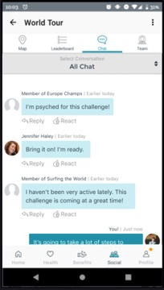
Cross Sponsor Member Experience
Privacy and Confidentiality
Teams may only be comprised of members from the same organization. Disclaimers make this process seamless.
A player will show as "Member of [Team Name]" with a generic profile image when they are from an opposing organization.
Members cannot friend members from other organizations
Members will be able to interact with other members from other organizations in the chat
Invite players from your organization
Suggested teams within your organization
Challenge chat feature: Avatars will display for members if a team is not in your organization

